Slide 1
CSE 442
LECRUE 8

Slide 2
Basic Input and Output Interfaces
The basic input device is a set of three-state buffers.
The basic output device is a set of data latches.
The term IN refers to moving data from the I/O device into the microprocessor
The term OUT refers to moving data out of the microprocessor to the I/O device.

Slide 3
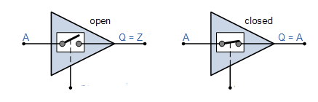
TRI-STATE BUFFER (74ALS244)
Tri-state buffer has 3pins- control pin, input pin, output pin
It can assume 3states- 1,0, high impedance(z)
When control pin is enabled o/p=i/p
When control pin is not enabled o/p=high impedance(z)
Control/enable (active low) | input | output
0 | 1 | 1
0 | 0 | 0
1 | X | z

Slide 4
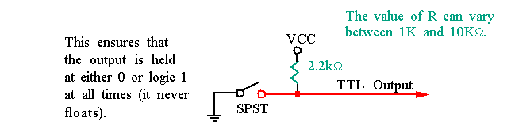
Input Devices
Input devices must be TTL(Transistor-transistor logic). TTL levels are a logic 0 (0.0 V–0.8 V) or a logic 1 (2.0 V–5.0 V)
If devices are TTL, they can be connected to the microprocessor and its interfacing components.
If devices are switch-based, they must be connected as follows
SPST=single-pole, single-throw switch

Slide 5
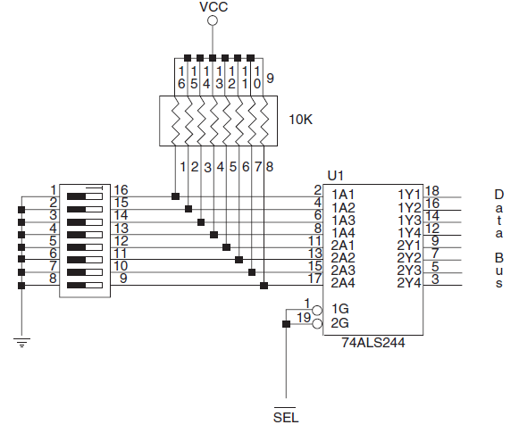
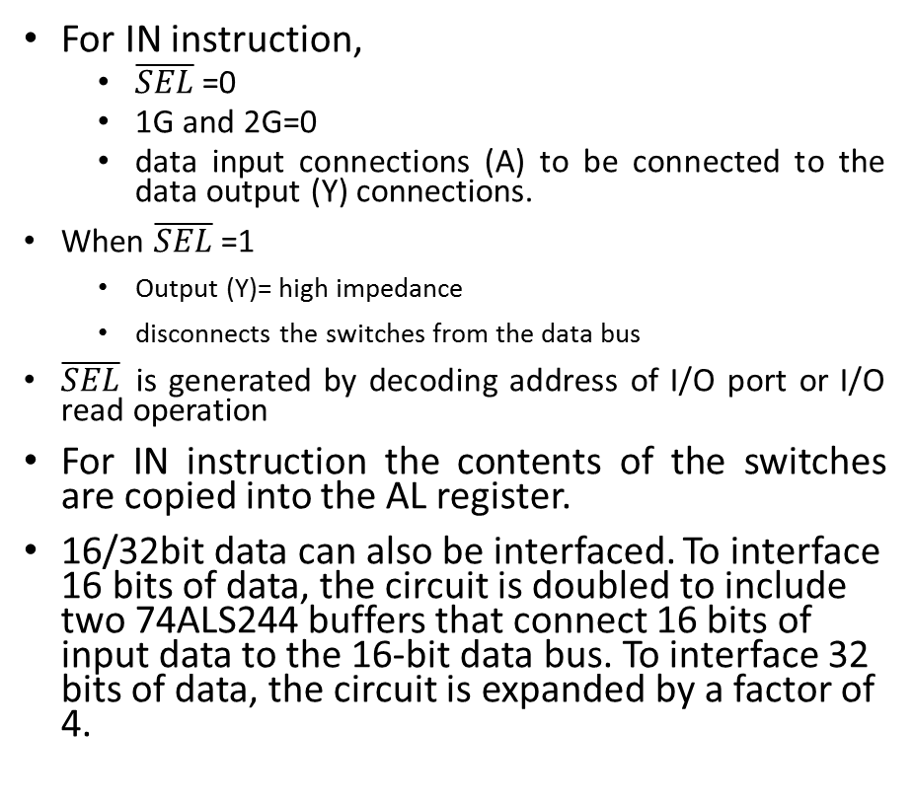
The Basic Input Interface
Pull up resistor
For IN instruction,
$\overline{SEL}$=0
1G and 2G=0
data input connections (A) to be connected to the data output (Y) connections.
When $\overline{SEL}$=1
Output (Y)= high impedance
disconnects the switches from the data bus
$\overline{SEL}$is generated by decoding address of I/O port or I/O read operation
For IN instruction the contents of the switches are copied into the AL register.
16/32bit data can also be interfaced. To interface 16 bits of data, the circuit is doubled to include two 74ALS244 buffers that connect 16 bits of input data to the 16-bit data bus. To interface 32 bits of data, the circuit is expanded by a factor of 4.
8 bit data to
AL of μprocessor
Tri-state buffer
Toggle switch

Slide 6
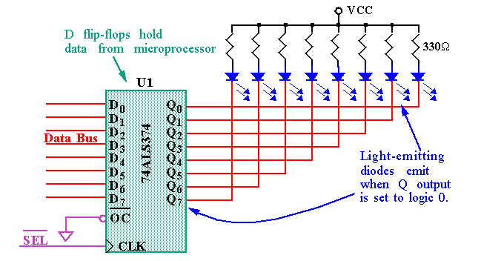

Basic Output Interface
Light Emitting Diode
8 bit data from
AL of μprocessor
The basic output device (from the microprocessor) is a set of latches.
When the OUT instruction executes, the data from AL, AX, or EAX are transferred to the latch via the data bus. Here, the D inputs of a 74ALS374 octal latch are connected to the data bus to capture the output data, and the Q outputs of the latch are attached to the LEDs.
When a Q output becomes a logic 0, the LED lights. Each time that the OUT instruction executes, the SEL signal to the latch activates, capturing the data output to the latch from any 8-bit section of the data bus. The data are held until the next OUT instruction executes.
Thus, whenever the output instruction is executed in this circuit, the data from the AL register appear on the LEDs.
$\overline{SEL}$ is used as CLK

Slide 7
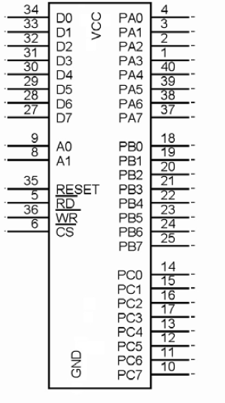
82C55 Programmable Peripheral Interface (PPI)
Has 3 modes of operation
MODE 0
MODE 1
MODE 2
24 pins for I/O
PORT A
PORT B
PORT C
24 pins are grouped into 2 groups
GROUP A
(PORT A (PA0-PA7)+ upper half of PORT C(PC4-PC7))
GROUP B
(PORT B(PB0-PB7)+ lower half of PORT C(PC0-PC3))

Slide 8
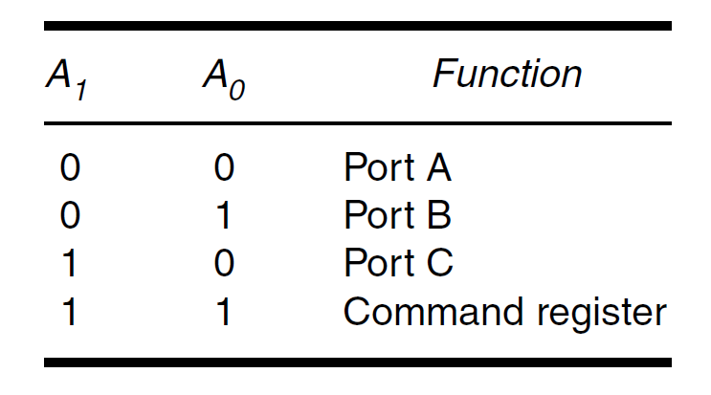

82C55 Programmable Peripheral Interface (PPI)
Selection pin of 8255 $\overline{CS}$
Register selection pin A0,A1
$\overline{RD}$selects read operation
$\overline{WR}$selects write operation

Slide 9
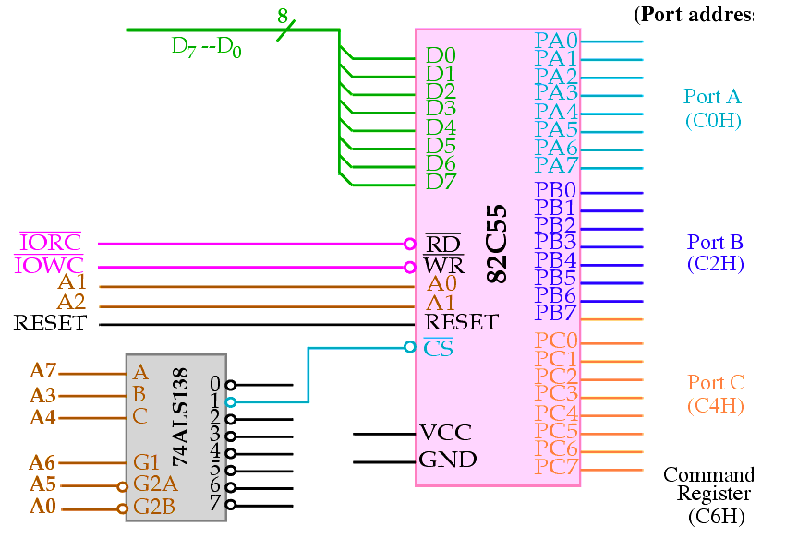
82C55 interface with 80386SX Microprocessor
From μprocessor
D0-D7 - data bus
A0-A7- Address bus
PROT address are-
A0=0
A5=0
A6=1
A4=A3=0
A7=0
FOR PORT A
A1=A2=0
Address (C0 H)
FOR PORT B
A1=1 A2=0
Address (C2 H)
FOR PORTC
A1=0 A2=1
Address (C4 H)
COMMAND REG
A1=A2=1
Address (C6 H)
To I/O devices
Sample question-
Interface 8255 with microprocessor such that the ports have a specified address.

Slide 10
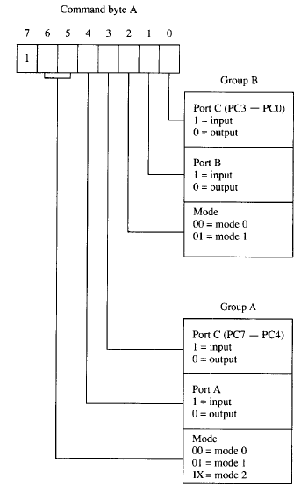
Programming the 82C55- I/O operation
D0-D7 from microprocessor
MODE 0
Basic I/O
Group A, B
MODE 1
Strobed I/O
Group A,B
MODE 2
Bidirectional I/O
Group A
D7=1 8255 in I/O
0
1

Slide 11
GROUP A operating on MODE 1 as I/P port GROUP B operating on MODE 0 as O/P port
Command byte
10111000
0
1
1
1
0
0
0

Slide 12
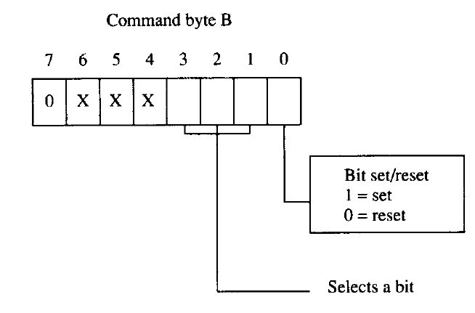
Programming the 82C55- BSR operation
D7=0 bit set/reset of PORT C
D3 | D2 | D1 | BIT
0 | 0 | 0 | 0
0 | 0 | 1 | 1
0 | 1 | 0 | 2
0 | 1 | 1 | 3
1 | 0 | 0 | 4
1 | 0 | 1 | 5
1 | 1 | 0 | 6
1 | 1 | 1 | 7
0
1
1
1
Set 3 at PORT C
Command byte
0xxx0111

Slide 13
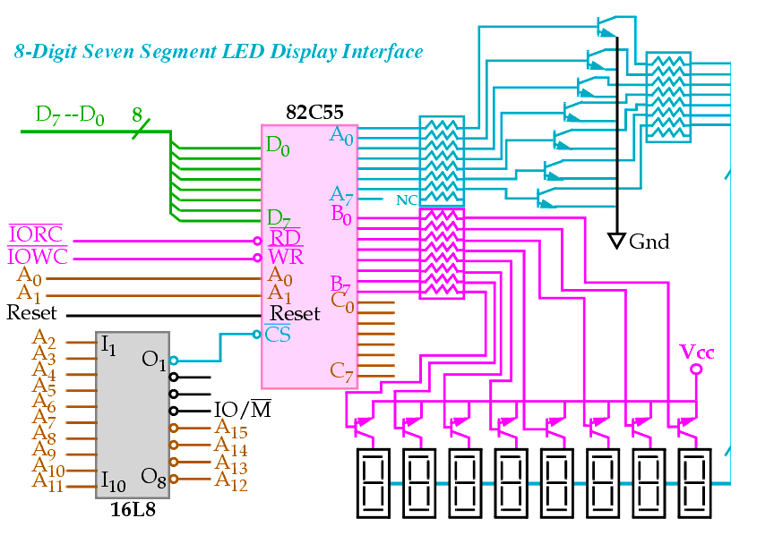
8 Digit 7 segment LED Display
39 ohm
- PORT A selects segment data inputs
- PORT B selects one display position
- only one of the eight displays is on at a time
2.2 KOhm
690 Ohm

